Slide 1
Welcome
Getting Listings from your SOI

Slide 2
Find & Grow Your SOI
Ninja Installation has 150 ways to Build a Database.
Members of your family
Spouse’s best friends
Your Dentist, Doctor, Specialist
Who cuts your hair? Family members hair?
Kid's schoolteachers
Who services your car?
Stockbroker, Accountant, Banker, Insurance Agent
Roofer, Plumber, Inspection Co., Lawn Svc
Who grooms your pets?
Who did you receive holiday cards from last year?

Slide 3
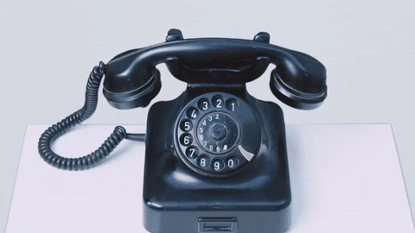
500 LB Phone…
Rich Vs. Poor
Successful Vs. Unsuccessful
Abondance Vs. Scarcity

Slide 4
Past Buyers
Don’t forget about past Buyers. They already know, like and trust you. Call to check in on them. “Hey guys I just wanted to check in on you; how do you like the house, the neighborhood?”
If they like the house and neighborhood it’s a good segue to ask if they have a relative or a friend that is looking to move to the neighborhood.
If they don’t love the house anymore or have a reason to move, like a baby on the way – you now have information that you can use to help them move to the next chapter of their life; and list the home (and likely sell them a new home).

Slide 5
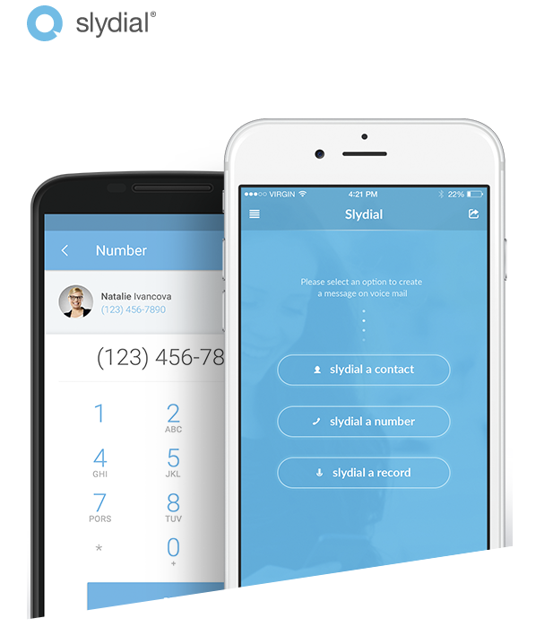
SlyDial
“Use slydial to sing happy birthday when you’re in a hurry, explain a report that’s too complicated to email, or navigate an awkward conversation.”

Slide 6
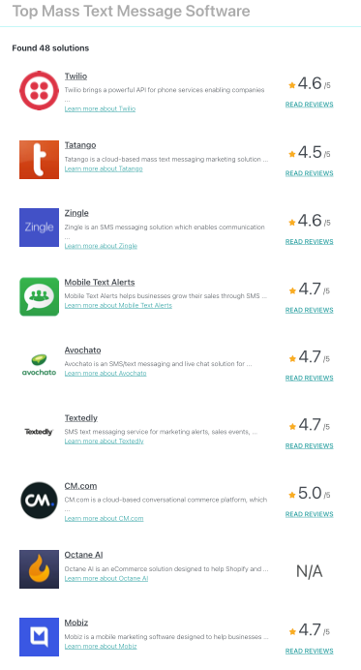
Bulk Text Message to SOI
There are many free SMS services that help you stay in touch with your Sphere via text.
Send a text to your sphere when you don’t have time for a longer phone conversation.
Text doesn’t replace calling or meeting, but it is a touch with your SOI.

Slide 7
Social Media Posts
“Thinking of Selling”
“What’s the Value of your Home”

Slide 8
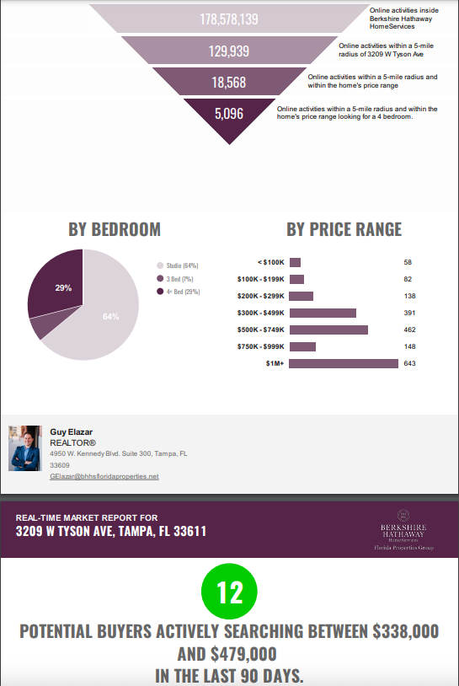
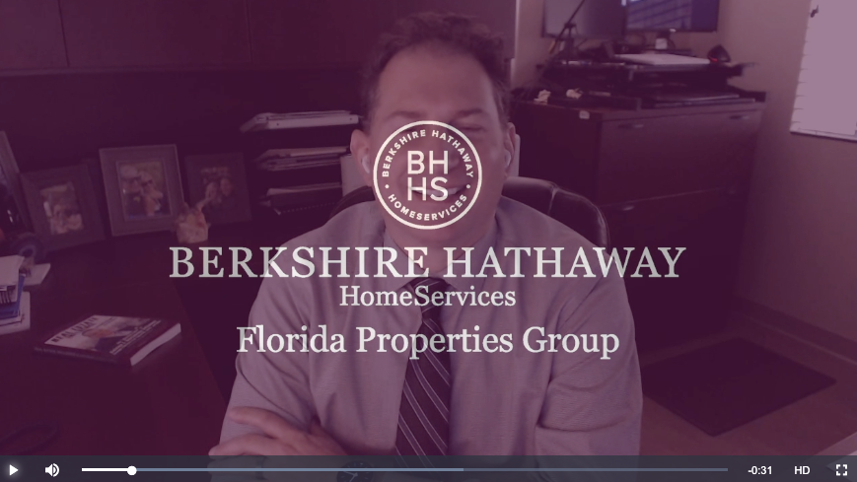
Video Unsolicited CMA
Send a video CMA to your SOI. Prepare a BMA from BuySide or a CMA and read the stats out loud in a video to them. Have a goal of doing one of these every day M-F.

Slide 9
Homes in newish Communities
If you sold a home to buyers in new communities 4-6 years ago, this may be a prime place to get listings.
Connect with these past clients and prospect the neighborhood.
Chances are that about 10% would like/need to sell.

Slide 10
Connect with you SOI frequently & on purpose
Have a plan to touch (on purpose) folks that you know.
Whether you use a CRM, Spreadsheet or a Calendar to log in your weekly touches…have a plan to connect with your SOI regularly.
What to say? Inform them of what’s going on around town – Share our ‘Cabbies’ contest
winners ☺ Discuss new restaurants,
things to do, places to go, etc.

Slide 11
Collect Data from your SOI
Find out important dates in your client’s life.
Get their Wedding Anniversaries, Kids Birthdays, Pet’s information, things they like (FORD).
Calendar this information and make sure you mail a Birthday Card, Anniversary Cards (and a call to the spouse reminding him/her that the anniversary is approaching).

Slide 12
Take it out of Social Media…
When you see a life event on social media (Birthday, New Baby, Anniversary, Kids going to College, Graduation, New Puppy, Loss of loved one, etc)—
Send a card or a letter referencing the event and personalize it to the person and the family.
Social Media provides a wealth of information to personally touch your SOI.

Slide 13
Get the most from an open house
You have a listing that’s amazing!
Let’s work on getting a few more in the neighborhood.
Use AdWerx to market to the residents in that neighborhood.
Order and mail postcards to the neighborhood letting them know you’re holding an open house.
Print Flyers - Door knock 10/10/20 and invite the neighbors to a private showing 30 minutes prior to start time. This is an opportunity for you to meet the neighbors , tell them about what you could do for them and potentially pick up additional listings in the area.
Ask the sellers if they know anyone in the neighborhood that is looking to move / looking to sell their home.

Slide 14
Sphere of Influence Vs. Influence your Sphere
Make sure you stay connected to your SOI regularly otherwise…someone else will.
Similarly in relationships, if you don’t pay enough attention to your spouse (boyfriend, girlfriend, partner)…someone else will ☺
Your SOI knows, likes and trusts you. When it comes to Real Estate – position yourself to be the ONLY one they go to.

